Slide 1
Logistic Regression

Slide 2
What is Logistic Regression?
Was used in the biological sciences in early twentieth century.
It was then used in many social science applications.
Is conducted when the dependent variable is dichotomous (binary).
Logistic regression is a predictive analysis.
Logistic regression is used to describe data.
To explain the relationship between one dependent binary variable and one or more nominal, ordinal, interval or ratio-level independent variables.

Slide 3
Types of Questions Binary Logistic Regression can answer?
How does the probability of getting lung cancer (yes vs. no) change for every additional pound a person is overweight and for every pack of cigarettes smoked per day?
Do body weight, calorie intake, fat intake, and age have an influence on the probability of having a heart attack (yes vs. no)?

Slide 4
Logistic Regression
Logistic Regression is used when the dependent variable(target) is categorical.
For example:
To predict whether an email is spam (1) or (0)
Whether the tumor is malignant (1) or not (0)

Slide 5
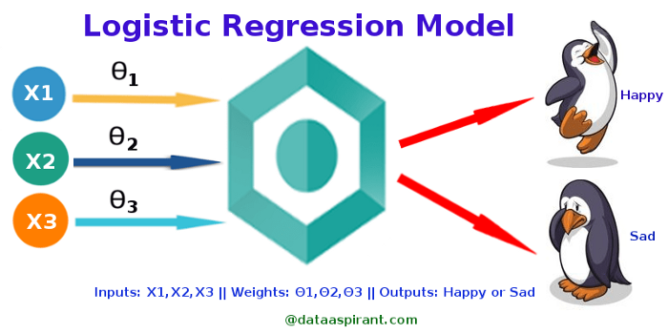
Logistic Regression

Slide 6
Comparison to Linear Regression
Given data on time spent studying and exam scores.
Linear Regression and logistic regression can predict different things:
Linear Regression
could help us predict the student’s test score on a scale of 0 - 100.
predictions are continuous (numbers in a range).
Logistic Regression
could help use predict whether the student passed or failed.
predictions are discrete (only specific values or categories are allowed).
We can also view probability scores underlying the model’s classifications.

Slide 7
Classifiers
This section focusses on the process of choosing a classifier.
Classification involves mapping our data points into a finite set of labels or the probability of a given label or labels.
Focus is on binary classification.
Table below shows a few examples of when we would want to use classification:
Questions | Answers
“Will someone click on this ad?” | 0 or 1 (no or yes)
“What number is this (image recognition)?” | 0,1,2, etc.
“What is this news article about?” | “Sports”
“Is this spam?” | 0 or 1
“Is this pill good for headaches?” | 0 or 1

Slide 8
Thought Experiment
There is art in data science—
it’s in translating human problems into the mathematical context of data science and back.
But we always have more than one way of doing this translation
—more than one possible model, more than one associated metric,
and possibly more than one optimization.

Slide 9
Thought Experiment
So the science in data science is—
given raw data, constraints, and a problem statement—
how to navigate through that maze and make the best choices.
Every design choice you make can be formulated as an hypothesis,
against which we will use rigorous testing and experimentation
to either validate or refute.

Slide 10
Thought Experiment
This process, whereby one formulates a well-defined hypothesis
and then tests it, might rise to the level of a science in certain cases.
Specifically, the scientific method is adopted in data science as follows:
You hold on to your existing best performer.
Once you have a new idea to prototype, set up an experiment wherein the two best models compete.
Rinse and repeat (while not overfitting).

Slide 11
Classifiers
Question here is : the given data, a real-world classification problem, and constraints, we need to determine:
Which classifier to use?
Which optimization method to employ?
Which loss function to minimize?
Which features to take from the data?
Which evaluation metric to use?

Slide 12
Classifiers
Concentrating on the first one – which classifier to use?
One possibility is to try them all, and choose the best performer.
This works if you have no constraints, or if you ignore constraints.
But usually constraints are a big deal—
you might have tons of data, or not much time, or both.
This is something people don’t talk about enough.

Slide 13
Classifiers
some constraints that are common across most algorithms.
Runtime:
Say you need to update 500 models a day.
That is the case at M6D
where their models end up being bidding decisions.
In that case, they start to care about various speed issues.
First, how long it takes to update a model
Second, how long it takes to use a model to actually make a decision if you have it.
This second kind of consideration is usually more important and is called runtime.

Slide 14
Classifiers
Some algorithms are slow at runtime.
For example, consider k-NN:
given a new data point in some large-dimensional space
you need to find the k closest data points to it.
In particular, you need to have all of your data points in memory.
Linear models, by contrast, are very fast, both to update and to use at
runtime.

Slide 15
Classifiers
2. You
One underappreciated constraint of being a data scientist
is your understanding of the algorithm.
You don’t have to be a master of every algorithm to be a good data scientist.
The truth is, getting the best fit of an algorithm often requires intimate knowledge of said algorithm.
Sometimes you need to tweak an algorithm to make it fit your data.
A common mistake for people not completely familiar with an algorithm
is to overfit when they think they’re tweaking.

Slide 16
Classifiers
2. You
One underappreciated constraint of being a data scientist
is your understanding of the algorithm.
You don’t have to be a master of every algorithm to be a good data scientist.
The truth is, getting the best fit of an algorithm often requires intimate knowledge of said algorithm.
Sometimes you need to tweak an algorithm to make it fit your data.
A common mistake for people not completely familiar with an algorithm
is to overfit when they think they’re tweaking.

Slide 17
Classifiers
2. Interpretability
We need to be able to interpret your model for the sake of the business.
Decision trees are very easy to interpret.
Random forests, on the other hand, are not, even though they are almost the same thing.
They can take exponentially longer to explain in full.

Slide 18
Classifiers
For example, by law,
credit card companies have to be able to explain
their denial-of-credit decisions.
so decision trees make more sense than random forests.
You might not have a law about it where you work
but it still might make good sense for your business to have a
simpler way to explain the model’s decision.

Slide 19
Classifiers
2. Scalability
There are three things we need to keep in mind when considering scalability:
1. Learning time: How much time does it take to train the model?
2. Scoring time: How much time does it take to give a new user a
score once the model is in production?
3. Model storage: How much memory does the production model
use up?

Slide 20
Classifiers
An useful paper to look at when comparing models:
“An Empirical Comparison of Supervised Learning Algorithms” which gives the following conclusions:
Simpler models are more interpretable but aren’t as good performers.
The question of which algorithm works best is problem dependent.
It’s also constraint-dependent.

Slide 21
M6D Logistic Regression Case Study
Brian and his team had three core problems as data scientists at M6D:
Feature engineering: Figuring out which features to use and how to use
them.
2. User-level conversion prediction: Forecasting when someone will click.
3. Bidding: How much it is worth to show a given ad to a given user?
This case study focuses on the second problem.
M6D uses logistic regression for this problem
because it’s highly scalable and works great for binary outcomes like clicks.

Slide 22
M6D Logistic Regression Case Study - Click Models
At M6D, they needed to match clients, which represent advertising companies to individual users.
Generally speaking, the advertising companies want to target ads to users based on a user’s likelihood to click.
Let’s discuss what kind of data they have available first,
and then how you’d build a model using that data.

Slide 23
M6D Logistic Regression Case Study - Click Models
M6D keeps track of the websites users have visited,
but the data scientists don’t look at the contents of the page.
Instead they take the associated URL
and hash it into some random string.
They thus accumulate information about users, which they stash in a vector.

Slide 24
M6D Logistic Regression Case Study - Click Models
As an example, consider the user “u” during some chosen time period:
u = < &ltfxyz, 123, sdqwe, 13ms&gtg >
This means “u” visited four sites
the URLs that “u” visited are hashed to those strings.
After collecting information like this for all the users,
they build a giant matrix whose columns correspond to sites
whose rows correspond to users, and a given entry is “1” if that user went to that site.
Note it’s a sparse matrix, because most people don’t go to all that many sites.

Slide 25
M6D Logistic Regression Case Study - Click Models
As an example, consider the user “u” during some chosen time period:
u = < &ltfxyz, 123, sdqwe, 13ms&gtg >
This means “u” visited four sites
the URLs that “u” visited are hashed to those strings.
After collecting information like this for all the users,
they build a giant matrix whose columns correspond to sites
whose rows correspond to users, and a given entry is “1” if that user went to that site.
Note it’s a sparse matrix, because most people don’t go to all that many sites.

Slide 26
M6D Logistic Regression Case Study - Click Models
To make this a classification problem,
they need to have classes they are trying to predict.
Let’s say in this case, they want to predict whether
a given user will click on a shoe ad or not.
So there’s two classes: “users who clicked on the shoe ad” and “users who did not click on the shoe ad.”
In the training dataset, then, in addition to the sparse matrix described,
they’ll also have a variable, or column, of labels.

Slide 27
M6D Logistic Regression Case Study - Click Models
They label the behavior “clicked on a shoe ad” as “1,” say, and “didn’t click” as “0.”
Once they fit the classifier to the dataset, for any new user,
the classifier will predict whether he will click or not (the label)
based on the predictors (the user’s browsing history captured in the URL matrix).

Slide 28
M6D Logistic Regression Case Study - Click Models
Now the goal is to build and train the model from a training set.
The output of a logistic regression model is
the probability of a given click in this context.
We could find a threshold so that
if the probability is above that threshhold (say, 0.75), you predict a click (i.e., you show an ad),
and below it you decide it’s not worth it to show the ad.

Slide 29
M6D Logistic Regression Case Study - Click Models
The point being here that unlike with linear regression—
which does its best to predict he actual value—
the aim of logistic regression isn’t to predict the actual value (0 or 1).
Its job is to output a probability.

Slide 30
M6D Logistic Regression Case Study - Click Models
The point being here that unlike with linear regression—
which does its best to predict he actual value—
the aim of logistic regression isn’t to predict the actual value (0 or 1).
Its job is to output a probability.

Slide 31
The Underlying Math
the beauty of logistic regression is
it outputs values bounded by 0 and 1
hence they can be directly interpreted as probabilities.
Let’s get into the math behind it a bit.
We want a function that takes the data
and transforms it into a single value bounded inside the closed interval 0,1 .

Slide 32
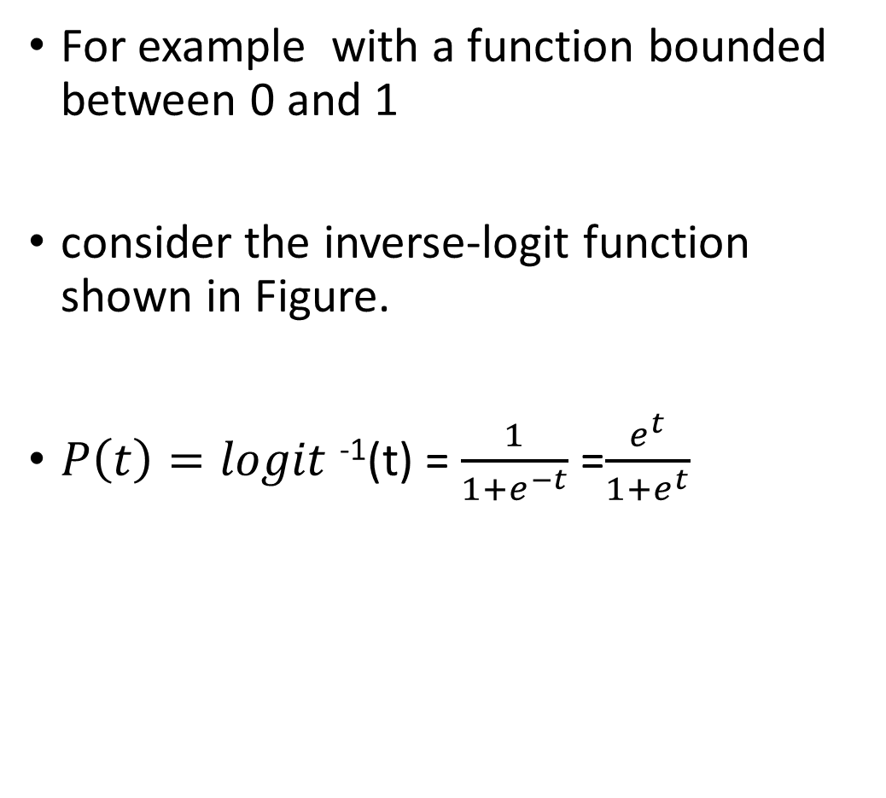
The Underlying Math
For example with a function bounded between 0 and 1
consider the inverse-logit function shown in Figure.
$P\left(t\right)=logit$⁻¹(t) = $\frac{1}{1+e^{−t}}$ =$\frac{e^{t}}{1+e^{t}}$
Fig: The inverse-logit function

Slide 33
The Underlying Math
when t is large, e−t is tiny so the denominator is close to 1 and
the overall value is close to 1.
Similarly when t is small, e−t is large
the denominator is large,
which makes the function close to zero.
that’s the inverse-logit function, which we’ll use to begin deriving a logistic regression model.

Slide 34
The Underlying Math
In order to model the data, we need to work
with a slightly more general function
that expresses the relationship between the data and a probability of a click.
Start by defining:

